Slide 1


Slide 2
What is an Entrepreneur?
An Entrepreneur (ahn’tra pra nur) is a person who organizes and manages a business undertaking, assuming the risk for the sake of profit. Any person (any age) who starts and operates a business is an entrepreneur.

Slide 3
Entrepreneurship
Agricultural students have been entrepreneurs since the beginning of agricultural education.

Slide 4
Entrepreneurship
The Smith-Hughes Act of 1917 (which provided federal funding for agricultural programs) required all students to have an entrepreneurship program – but they weren’t called entrepreneurs back then.

Slide 5
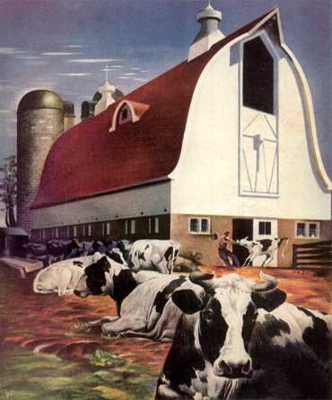

Early Entrepreneurship
These early entrepreneurship programs were called different names:
  Farming Program
  Productive or Production
  Enterprises
  Ownership

Slide 6
Early Entrepreneurship
The early SAE Entrepreneurship program primarily involved:
  Raising Livestock
  Growing Crops

Slide 7
Entrepreneurship Today
Today, agricultural students are involved in many different types of entrepreneurial activities.
Entrepreneurship in agriculture can still be raising livestock and growing crops, but it can be much, much more than that.

Slide 8
Agricultural Entrepreneurship
Entrepreneurship: The student plans, implements, operates and assumes financial risks in a farming activity or agricultural business. In entrepreneurship programs, the student owns the materials and other required inputs and keeps financial records to determine return to investments.

Slide 9

Agri-Entrepreneurs Example
Lawn Maintenance Service

Slide 10

Agri-Entrepreneurs Example
Raise and Sell Fishing Bait

Slide 11

Agri-Entrepreneurs Example
Custom Crop Harvesting

Slide 12

Agri-Entrepreneurs Example
Pet Sitting Service

Slide 13

Agri-Entrepreneurs Example
Fishing Guide

Slide 14

Agri-Entrepreneurs Example
Tractor and Farm Equipment Detailing

Slide 15

Agri-Entrepreneurs Example
Operating a Roadside Marketing Selling Produce

Slide 16

Agri-Entrepreneurs Example
Making and Selling Christmas Wreathes

Slide 17

Agri-Entrepreneurs Example
Operating a Small Engine Repair Service

Slide 18

Three Aspects of Entrepreneurship
1. The identification/recognition of market opportunity and the generation of a business idea (product or service) to address the opportunity

Slide 19

Three Aspects of Entrepreneurship
2. The marshalling and commitment of resources in the face of risk to pursue the opportunity

Slide 20

Three Aspects of Entrepreneurship
3. The creation of an operating business organization to implement the opportunity-motivated business idea

Slide 21
Successful Entrepreneurs
According to the Small Business Administration, successful entrepreneurs have five characteristics:
  Drive, which is defined as the most important attribute. Entrepreneurs can expect long hours, high stress and endless problems, as they launch a new business.

Slide 22
Successful Entrepreneurs
According to the Small Business Administration, successful entrepreneurs have five characteristics:
  Thinking Ability, or the characteristic that encompasses creativity, critical thinking, analytical abilities and originality.

Slide 23
Successful Entrepreneurs
According to the Small Business Administration, successful entrepreneurs have five characteristics:
  Aptitude for Human Relations. This characteristic recognizes the importance of the ability to motivate employees, sell customers, negotiate with suppliers and convince lenders. Personality plays a big part in success in this area..

Slide 24
Successful Entrepreneurs
According to the Small Business Administration, successful entrepreneurs have five characteristics:
  Communication Skills, or the ability to make yourself understood.

Slide 25
Successful Entrepreneurs
According to the Small Business Administration, successful entrepreneurs have five characteristics:
  Technical Ability speaks to the need of the entrepreneur to know their product and their market. They must consider the long- and short-term implications of their decisions, their strengths and weaknesses, and their competition. In short, they need strategic management skills.

Slide 26

Entrepreneurship
Some advantages
  You are your own boss
  Enjoy the profits from you efforts
  Sense of pride in your business
  Flexibility in your work schedule

Slide 27

Entrepreneurship
Some disadvantages
  Will need to put in long hours
  Need money to start
  Have to keep up with government rules and regulations
  May have to mark hard decisions (hiring, firing, etc.)
  May lose money

